Slide 1
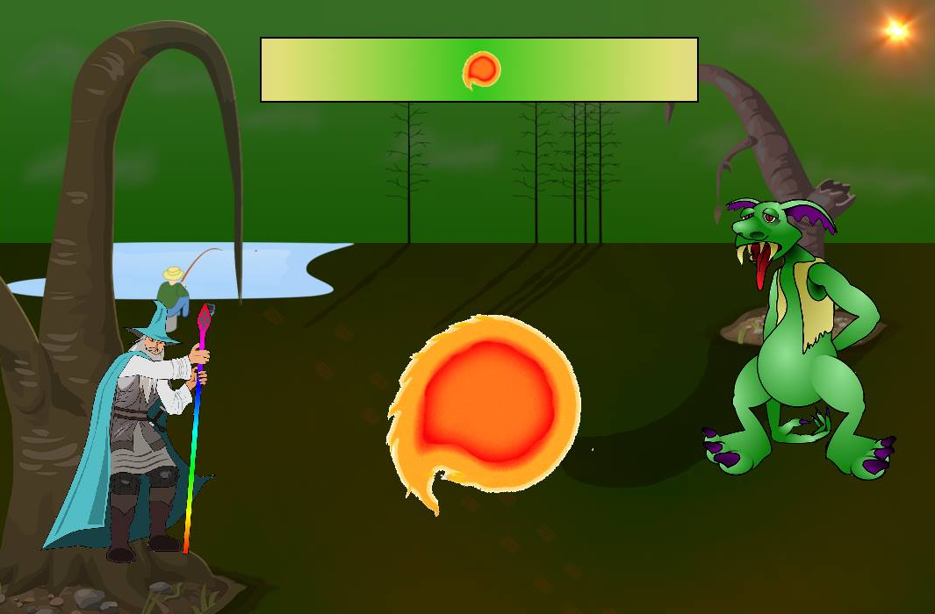
Boolean Battles
Alex Jones, Jack Williams, Liam Wardle, Charles Crawford
Notes:
Now we will discuss the implementation and management of designing the game

Slide 2



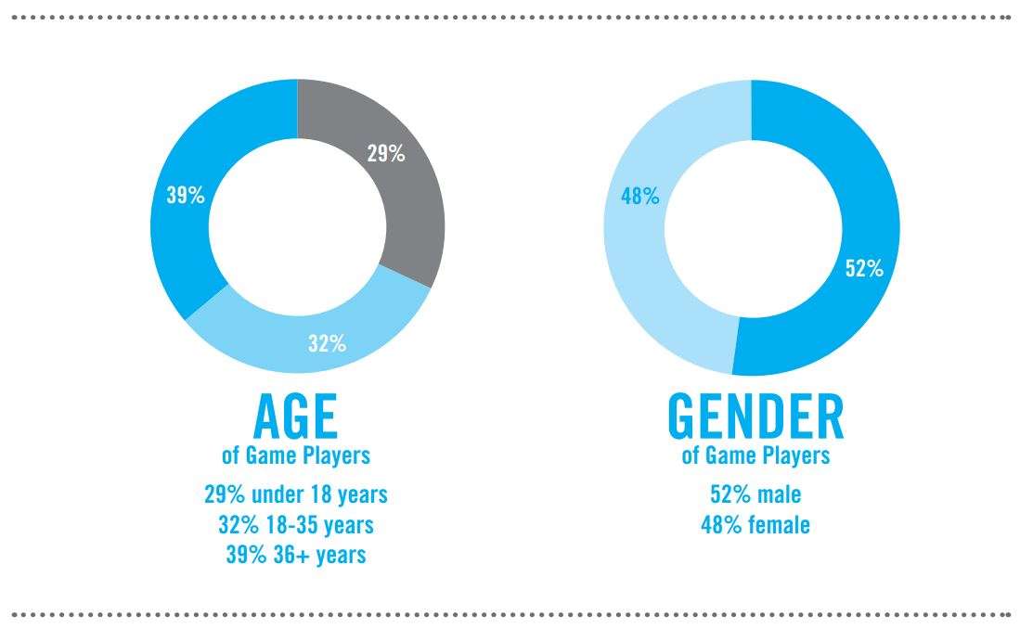
Target Audience
Young, future generation programmers and scientists
Aim to target 12-15 year old students
Teaching aid in any form of learning environment
No specific gender aim
Notes:
First off I'll talk about the target audience
Aim 12-15 year old students studying ICT at school
May attract males more but not designed for males, as genders who play games are equal
Aimed to be enjoyable by anybody though

Slide 3

Techniques
Waterfall
Changed to agile techniques
Supports changing requirements
Better project evaluation
Pair programming
Collective ownership
Established a style

Slide 4




Development tools
C programming language
GIMP – Pixabay(open source)
SDL
Gedit

Slide 5
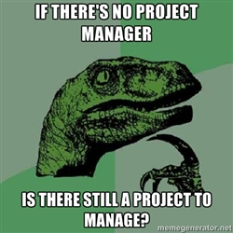


Project Management
No single Project Manager
Weekly team meetings and communication via Social Media
(FaceBook, Whatsapp)
Project Managing tools including GitHub and Waffle

Slide 6
Learning References
LazyFoo
Gimp tutorials
Wiki.libsdl.org

Slide 7
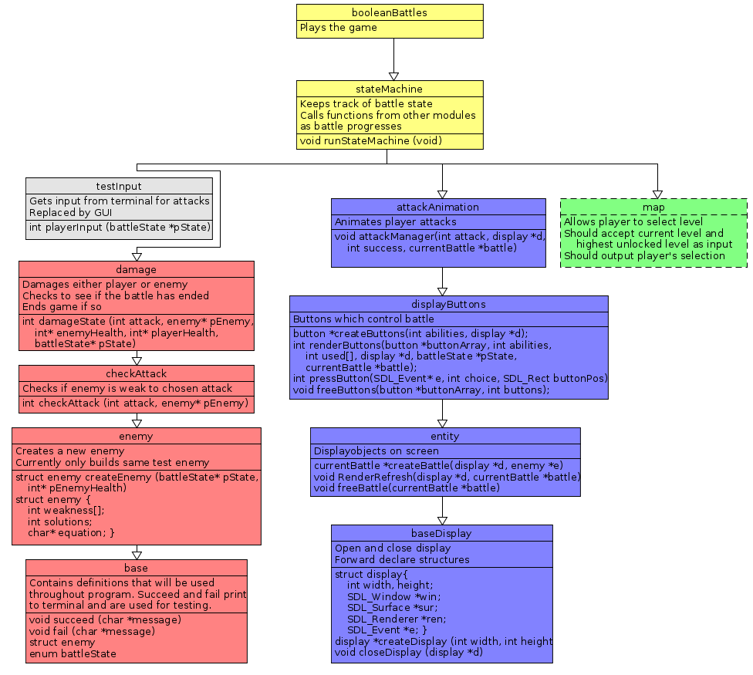
Module Diagram
Tree split into three distinct branches that could be worked on independently
Each module designed to be tested independently of modules above it
testInput module used to test Logic branch with out GUI interface from Display branch
Display branch was one module originally, but was split up for testing and flexibility

Slide 8
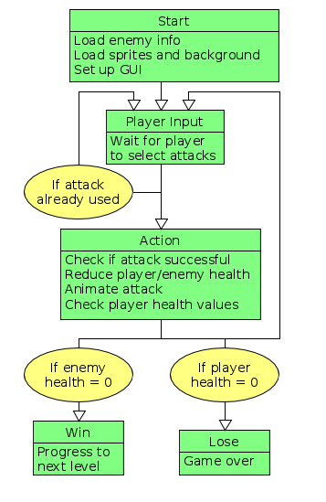
State Machine
State machine to govern game mechanics
Majority of functions split between Player Input and Action
Originally included an enemy turn as well, but was removed to make game simpler, more enjoyable and more focussed on boolean logic

Slide 9
Evaluation
What went well?
  Initial simple design
  Adapting to change
  Educational, Enjoyable, Ease of understanding, Repeatable?
Not so well?
  Group communication
  Resolve conflicts/disagreements earlier
  Implementation of map

Slide 10

Enemy database
Damage animation
Add tracked moves, health bars to GUI
Win/lose animation
Increased number of enemies/levels
Increased difficulties
Map integration

Slide 11
Questions?

